Slide 1
Indigenous and Storytelling Aspects of the Coalition of Immokalee Workers’ ANSWER to Modern Day Slavery
Grace Ann Rosile, David Boje, Cora Voyageur, Brian Calliou

Slide 2
Does most of
your food come
from the farm
down the road
from where you live?
NOT THESE DAYS!
Notes:
Animated picture and caption sweep in
(Basic)
To reproduce the shape effects on this slide, do the following:
On the Home tab, in the Slides group, click Layout, and then click Blank.
On the Home tab, in the Drawing group, click Shapes, and then under Lines click Line (first option from the left).
On the slide, press and hold SHIFT, and then drag to draw a straight, vertical line.
Select the line. Under Drawing Tools, on the Format tab, in the Size group, in the Shape Height box, enter 7.5”.
Also on the Format tab, in the Shape Styles group, click the Format Shape dialog box launcher. In the Format Shape dialog box, click Line Color in the left pane. In the Line Color pane, select Solid line, click the button next to Color, and then under Theme Colors click Black, Text 1 (first row, second option from the left).
Also in the Format Shape dialog box, click Line Style in the left pane. In the Line Style pane, in the Weight box, enter 2 pt.
Also in the Format Shape dialog box, click Glow and Soft Edges in the left pane. In the Glow and Soft Edges pane, do the following:
Under Glow, click the button next to Presets, and then under Glow Variations click Blue, 5 pt glow, Accent color 1 (first row, first option from the left).
Click the button next to Color, and then under Theme Colors click White, Background 1 (first row, first option from the left).
On the Home tab, in the Drawing group, click Arrange, point to Align, and then do the following:
Click Align to Slide.
Click Align Center.
Click Align Middle.
On the slide, select the line. On the Home tab, in the Clipboard group, click the arrow next to Copy, and then click Duplicate.
Drag the duplicate line slightly off the right edge of the slide.
With the duplicate line still selected, on the Home tab, in the Drawing group, click Arrange, point to Align, and then do the following:
Click Align to Slide.
Click Align Middle.
On the Insert tab, in the Images group, click Picture. In the Insert Picture dialog box, select a picture, and then click Insert.
On the slide, select the picture. Under Picture Tools, on the Format tab, in the Size group, click the Size and Position dialog box launcher. In the Format Picture dialog box, resize or crop the image so that the height is set to 7.5” and the width is set to 5”. To crop the picture, click Crop in the left pane, and in the right pane, under Crop position, enter values into the Height, Width, Left, and Top boxes. To resize the picture, click Size in the left pane, and in the right pane, under Size and rotate, enter values into the Height and Width boxes.
On the Home tab, in the Drawing group, click Arrange, point to Align, and then do the following:
Click Align to Slide.
Click Align Right.
Click Align Middle.
To reproduce the text effects on this slide, do the following:
On the Insert tab, in the Text group, click Text Box. On the slide, drag to draw a text box.
Enter text in the text box, and then select the text. On the Home tab, in the Font group, do the following:
In the Font list, select Arial.
In the Font Size list, select 28.
Click Bold.
Click the button next to Font Color, and then under Theme Colors click White, Background 1 (first row, first option from the left).
On the Home tab, in the Paragraph group, click Align Text Right to align the text right in the text box.
Drag the text box onto the left half of the slide.
To reproduce the background effects on this slide, do the following:
On the Design tab, in the Background group, click Background Styles and then click Format Background. In the Format Background dialog box, click Fill in the left pane, select Gradient fill in the Fill pane, and then do the following:
In the Type list, select Linear.
In the Angle box, enter 90.
Under Gradient stops, click Add gradient stops or Remove gradient stops until two stops appear in the slider.
Also under Gradient stops, customize the gradient stops as follows:
Select the first stop in the slider, and then do the following:
In the Position box, enter 40%.
Click the button next to Color, and then under Theme Colors click Black, Text 1 (first row, second option from the left).
In the Transparency box, enter 0%.
Select the next stop in the slider, and then do the following:
In the Position box, enter 100%.
Click the button next to Color, and then under Theme Colors click Black, Text 1, Lighter 50% (second row, second option from the left).
In the Transparency box, enter 0%.
To reproduce the animation effects on this slide, do the following:
Select the line off the right edge of the slide. On the Animations tab, in the Advanced Animation group, click Add Animation, and then under Entrance click Fly In.
Also on the Animations tab, in the Animation group, click Effect Options, and then click From Left.
On the Animations tab, in the Timing group, in the Duration box, enter 0.5.
On the Animations tab, in the Timing group, in the Start list, select After Previous.
Select the line at the center of the slide. On the Animations tab, in the Advanced Animation group, click Add Animation, and then under Entrance click Fly In.
Also on the Animations tab, in the Animation group, click Effect Options, and then click From Right.
On the Animations tab, in the Timing group, in the Duration box, enter 1.
On the Animations tab, in the Timing group, in the Start list, select After Previous.
Select the picture. On the Animations tab, in the Advanced Animation group, click Add Animation, and then under Entrance click Wipe.
Also on the Animations tab, in the Animation group, click Effect Options, and then click From Right.
On the Animations tab, in the Timing group, in the Duration box, enter 1.
On the Animations tab, in the Timing group, in the Start list, select With Previous.
Select the text box. On the Animations tab, in the Advanced Animation group, click Add Animation, and then under Entrance click Fly In.
Also on the Animations tab, in the Animation group, click Effect Options, and then click From Right.
On the Animations tab, in the Timing group, in the Duration box, enter 1.
On the Animations tab, in the Timing group, in the Start list, select With Previous.

Slide 3
Ensemble Leadership: Indigenous roots, egalitarian & heterarchical
THE Coalition of Immokalee Workers (CIW) use ENSEMBLE LEADERSHIP to create
THE MOST SUCCESSFUL PROGRAM FOR COMBATTING MODERN-DAY SLAVERY
HOW? The Fair Foods Program using
Worker-Driven Social Responsibility (WSR)

Slide 4
Ensemble Leadership: Indigenous roots, egalitarian & heterarchical
HOW? The Fair Foods Program using
Worker-Driven Social Responsibility (WSR)
WORKER-DRIVEN
VICTIM-FRIENDLY
POWERFUL ENFORCEMENT TEETH

Slide 5
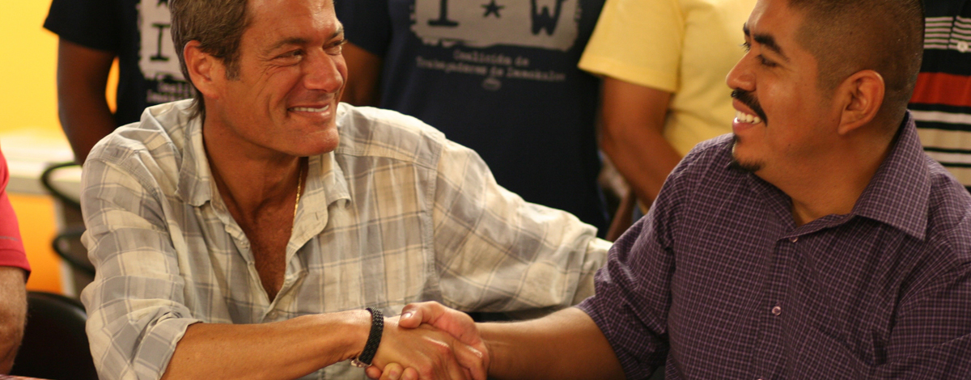
“…I asked… if anyone had actually individually met anyone from the Coalition of Immokalee Workers, and if anyone had had a conversation with them,” he says.
“It was very clear that we had left it up to the industry groups to do it, and we agreed that we should meet with them directly….My COO Billy Heller and I sat down with Lucas Benitez, the founder of the coalition, and realized that our goals were the same.”
John Esformes, President of the Pacific Tomato Growers of Florida

Slide 6
“I have been in the fields all my life, I have seen boys become men in the tomato fields, I have seen a great deal. And now I also see that things are better, now we are not treated like dogs – I am grateful to people like you. You are welcome here.”
From the CIW web site

Slide 7
SINCE ciw FAIR FOODS STANDARDS COUNCIL (FFSC) PROGRAM’S INCEPTION IN 2011 ... 12,000 WORKERS WERE INTERVIEWED 33,000 WERE EDUCATED BY ciw FACE-TO-FACE 135,000 RECEIVED “KNOW YOUR RIGHTS” MATERIALS ….ALL BETWEEN 2011 AND 2015 !
BY 2017,
OVER 1700
COMPLAINTS WERE HANDLED

Slide 8
“One of the great human rights success stories of our day.” Washington Post Op/Ed
“The Fair Food Program is a smart mix of tools. We are eager to see the Fair Food Program… serve as a model elsewhere in the world.”
United Nations Working Group on Business and Human Rights

Slide 9
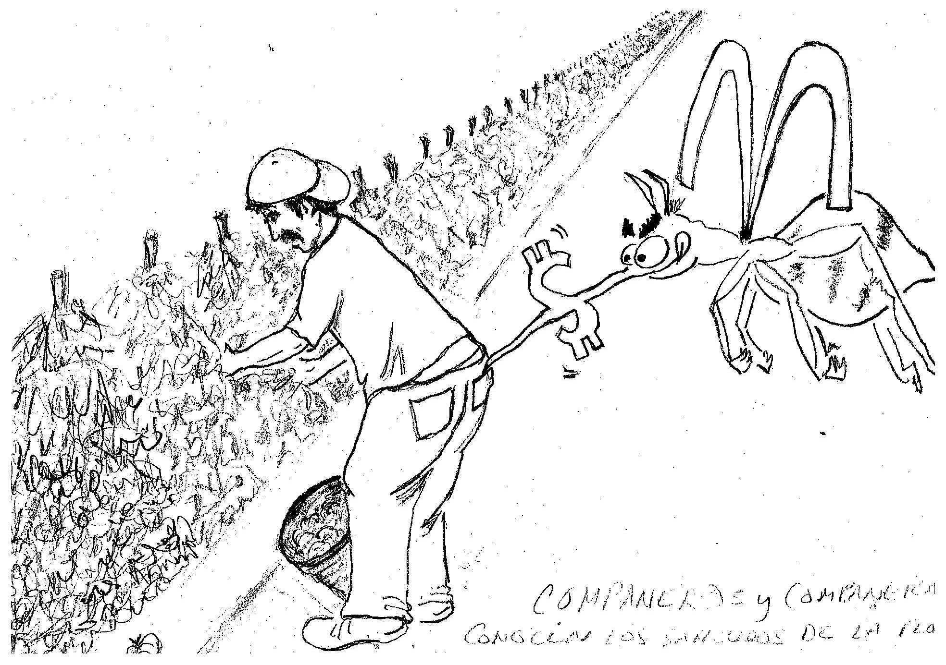

Slide 10
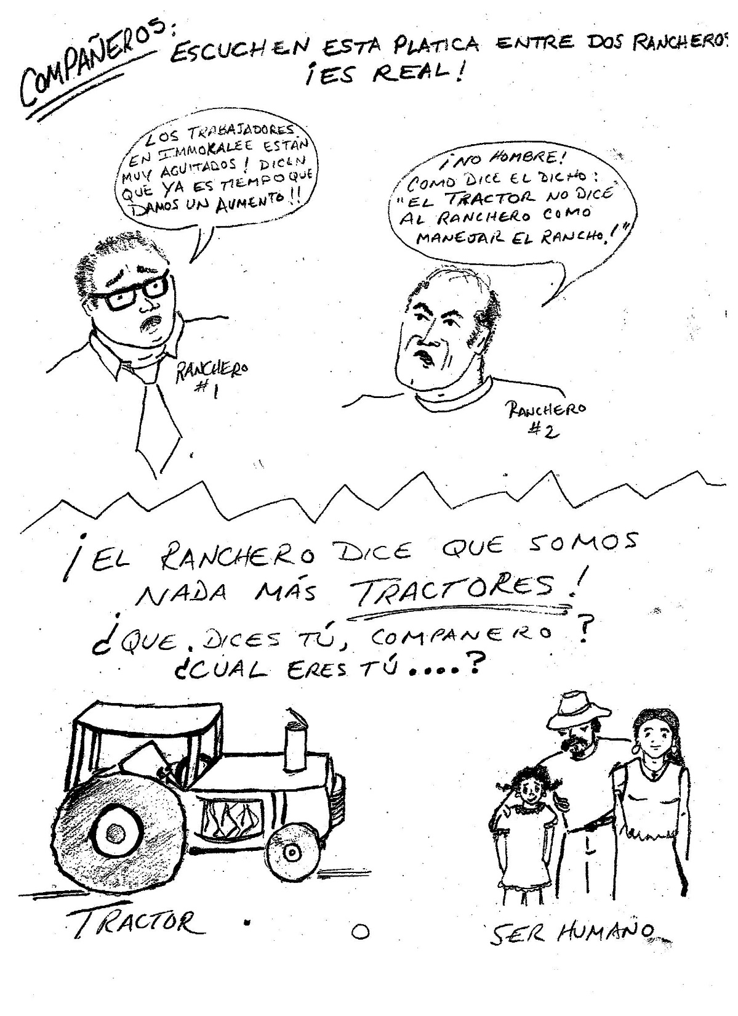

Slide 11
Fair Food Standards Council
MISSION: to monitor the development of a sustainable agricultural industry that advances
the human rights of farmworkers,
the long-term interests of growers, and
the ethical supply chain concerns of retail food companies
through implementation of the Fair Food Program.

Slide 12
CNN Freedom Project May 30, 2017 update
http://www.cnn.com/2017/05/30/world/ciw-fair-food-program-freedom-project/

Slide 13
Food Chains documentary film
https://youtu.be/lqZLrXVAde4

Slide 14
Food Chains documentary film https://www.youtube.com/watch?v=-k4c6QdCJi4

Slide 15
https://youtu.be/b6s4YAOISns?t=3 http://www.fairfoodstandards.org/ video clip including Harvest of Shame
<iframe width="750" height="422" src="https://www.youtube.com/embed/b6s4YAOISns" frameborder="0" allowfullscreen></iframe>

Slide 16
Workers fight for rights at 'ground zero for US slavery‘ http://www.cnn.com/specials/world/freedom-project https://www.google.com/url?sa=t&rct=j&q=&esrc=s&source=web&cd=1&cad=rja&uact=8&ved=0ahUKEwi_8qCR5JjUAhUhw1QKHXd2BC4QqOcBCCYwAA&url=http%3A%2F%2Fwww.cnn.com%2F2017%2F05%2F30%2Fworld%2Fciw-fair-food-program-freedom-project%2F&usg=AFQjCNHz-UHZZ8THmx4kmz6Wnc76ggWUNw http://www.cnn.com/2017/05/30/world/ciw-fair-food-program-freedom-project/
www.cnn.com/2017/05/30/world/ciw-fair-food-program-freedom-project/

Slide 19
4 KEYS TO THE CIW / FAIR FOODS PROGRAM SUCCESS: 1. EMPHASIS ON RELATIONSHIP 2. LACK OF RELIANCE ON TEXT 3. NON-HUMAN-CENTRIC VIEW OF LIFE 4. NON-LINEAR INDIGENOUS & LIVING STORY PROCESSES

Slide 20
4 KEYS TO THE CIW / FAIR FOODS PROGRAM SUCCESS: 1 of 4: EMPHASIS ON RELATIONSHIP BUILD TRUST USING WORKER-TO-WORKER TRAINING AND MONITORING

Slide 21
4 KEYS TO THE CIW /FAIR FOODS PROGRAM SUCCESS: 2 of 4: LACK OF RELIANCE ON TEXT FACE-TO-FACE INTERVIEWS WITH AT LEAST 50% OF THE WORKERS IN A LOCATION THEATRICS TRAINING PARTICIPATIVE STORYTELLING: WHAT DO YOU SEE? FIELD MONITORS STAFF 24-HR COMPLAINT LINES

Slide 22
4 KEYS TO THE CIW/FAIR FOODS PROGRAM SUCCESS: 3 of 4: NON-HUMAN-CENTRIC VIEW OF LIFE WE DE-VALUE EARTH AND ANIMALS WE DEVALUE THOSE WHO WORK WITH EARTH AND ANIMALS WE CALL THEM “RESOURCES” TO BE USED

Slide 23
4 KEYS TO CIW/FAIR FOODS PROGRAM SUCCESS: 4 of 4: INDIGENOUS and LIVING STORY PROCESSES HEIDEGGER’S FORE-CARING, FORE-HAVING, FORE-CONCEPTION, FORE-HAVING, FORE-TELLING THEATRICAL AND PARTICIPATIVE STORYTELLING: “What do you see?”

Slide 24
YOUR TASK: 1. FORM GROUPS OF 4-5 2. DISCUSS: WHICH OF THESE IDEAS MIGHT WORK IN OTHER CONTEXTS discussed here at EGOS: FASHION industry, GARMENT industry, TRUCKING industry, ACADEMIC industry, other 3. TAKE 5 min to discuss 4. REPORT to the GROUP

Slide 25
THANK YOU
Grace Ann Rosile
garosile@nmsu.edu
Slides available at http://davidboje.com
Join us December 13-15, 2017, in Las Cruces, NM for the 7th Annual QUANTUM STORYTELLING CONFERENCE see http://davidboje.com/quantum for details
Welcome Reception Wed evening, Full Day Sessions on Thursday 13th and Friday 14th, Half Day Saturday 15th, followed by Sightseeing on Sunday 16th if you want to stay over and go to White Sands or to Cliff Dwelling in Silver City.

